Slide 1
Domestic Saving and International Capital Flows
Presented By: Ayush Raj Pandey Harsh Mittal
Martin Feldstein and Charles Horioka

Slide 2
Questions Addressed
The text questions the international mobility of the world’s supply of capital.
It asks if capital flows among industrial countries to equalize the yield to investors.
Alternatively, it questions if the saving that originates in a country remains to be invested there.
It acknowledges that the truth may lie somewhere between these two extremes.
The answers to these questions are important for understanding the international capital market.
These answers are also critical for analyzing a wide range of issues including the nation’s optimal rate of saving and the incidence of tax changes.

Slide 3
Optimal Saving Policy
The text discusses the implications of international capital mobility for policy and analysis.
In a closed economy, the national return on additional saving is the domestic marginal product of capital. The government’s decision to increase the saving rate depends on whether this offers a high enough reward to justify postponing consumption.
In contrast, if capital is perfectly mobile between countries, most of any incremental saving will leave the home country or replace other foreign source capital that would otherwise be invested in the home country.
The yield to the home country on the additional saving is the net-of-tax return received by the investor and the tax revenue.
The optimal savings policy depends critically on whether the ‘closed economy’ or the ‘perfect world capital market’ is a better approximation to reality.

Slide 4
Tax Incidence
The extent of capital mobility is also crucial for the analysis of tax incidence.
In a closed economy with a fixed capital stock, a tax on the income of all capital used in production is borne completely by the owners of capital.
If capital is free to leave the country, a large part of the burden could be shifted to domestic labour and to foreign capital owners.
Labour’s ability to shift a tax on labour income to domestic owners of capital by a reduction in labour supply would be less if capital were free to escape abroad.
Statistical evidence in favour of the complete world capital mobility assumption would require a major revision of our theories of tax incidence.

Slide 5
Does Free Flow Exist?
The text discusses the view that capital flows among countries to equate net-of-tax rates of return. This is evident from the yields on short-term securities in the Eurocurrency market and the forward prices of those currencies.
However, similar measures of expected real net-of-tax yields on long-term portfolio capital or direct investments cannot be observed.
It suggests that long-term capital movements would also equalise net-of-tax yields, but there are reasons to be sceptical about the extent of such long-term arbitrage.
The assumption that investment will flow to the highest yielding opportunity is only one extreme form of the portfolio theory of investment. More generally, since the risks of investing in different countries and currencies are not perfectly correlated, investors will tend to choose a portfolio in which expected yields are not equal.

Slide 6
Does Free Flow Exist?
Even if all investors were well informed and eager to seek the highest yield without regard to risk, the full mobility of capital would be impeded by official restrictions on the export of capital.
Important institutional rigidities also tend to keep a large segment of domestic saving at home.
There is indirect evidence in the pattern of investment flows that capital does not move to maximise each investor’s net-of-tax return.
Much of the direct investment in foreign markets appears to be associated with implementing marketing strategies, exploiting production knowledge, or overcoming trade restrictions rather than with an undifferentiated pursuit of profit opportunities.
This is probably the major reason why individual countries are both importers and exporters of capital.

Slide 7
Specification and Data
The paper uses data on major industrial countries to measure the relationship between a higher domestic saving rate and a higher rate of domestic investment.
With perfect world capital mobility, there should be no relation between domestic saving and domestic investment.
If incremental saving tends to be invested in the country of origin, differences among countries in investment rates should correspond closely to differences in saving rates.
There is substantial variation in domestic saving rates among the OECD countries. For the period 1960-74, the ratio of gross domestic saving to gross domestic product averaged 0.250 for the 21 OECD countries.

Slide 8

Estimation
The paper estimates equation to assess the relation between savings rates and investment rates in a country.
With perfect world capital mobility, an increase in the saving rate in one country would cause an increase in investment in all countries.
The distribution of the incremental capital among countries would vary positively with each country’s initial capital stock and inversely with the elasticity of the country’s marginal product of capital schedule.
In the extreme case where a country is infinitesimally small relative to the world economy, the value of the coefficient(β) in the equation implied by perfect world capital mobility would be zero.
For a relatively large country, the value of the coefficient (β) would only be of the order of magnitude of its share of total world capital.

Slide 9
Estimation
Estimates of the coefficient close to one would indicate that most of the incremental saving in each country has remained there.
A high observed value of the coefficient could reflect other common causes of the variation in both saving and investment.
The findings of a high value of the coefficient would be strong evidence against the hypothesis of perfect world capital mobility.
The equation can also be interpreted in terms of foreign investment flows with coefficient ‘β-1’.
Testing the hypothesis that ‘β’ equals one is equivalent to testing the hypothesis that the international capital flows do not depend on domestic savings rates.

Slide 10
Basic Results
The estimate of the coefficient(β) for the entire 15-year sample is 0.89 when gross saving and investment are used and 0.94 when net saving and investment are used.
Neither coefficient is significantly different from one, contradicting the hypothesis of perfect world capital mobility.
Most of any incremental saving tends to remain in the country in which the saving is done.
The savings-rate coefficients based on the net flows are higher than the corresponding coefficients based on gross flows.
A consistent estimate can be obtained with instrumental variable estimation using the gross saving rate as an instrument.
The instrumental variable estimates of the coefficient are all lower than the ordinary least squares estimates but the difference is never as large as 0.1.

Slide 11
Modifications in the Equation
The linear approximation of the equation is a simplification and a quadratic generalisation of the equation was estimated.
The coefficient of the squared value of S/Y is always statistically insignificant and positive, indicating no nonlinearity.
The high coefficient in the relation between domestic investment and domestic saving may reflect the impact of some third variable.
According to the life-cycle theory of saving, the most important exogenous determinant of the aggregate saving rate is the rate of population growth.
Adding the mean annual growth rate of population as an additional variable in the equation had almost no effect on the estimated value of the coefficient.
There may be other variables that independently influence both saving and investment.

Slide 12

Modifications contd.
The paper examines the possibility that the link between domestic investment and domestic saving varies with the degree of openness of the economy.
It seems plausible that small economies that engage in substantial international trade will have a much weaker link between domestic saving and domestic investment than large and nearly autarchic economies.
An extension of the equation was estimated in which the value of the coefficient is permitted to vary with a measure of the openness of the economy.
The first measure of openness(X_{i}) is the share of trade in GDP as measured by the sum of exports and imports per dollar of GDP. The estimates of the coefficient(β₁) are negative as expected but very small and not significantly different from zero.
As an alternative measure, the size of the economy was used based on the reasoning that a large economy is more likely to be self-contained and therefore to invest a higher share of its savings domestically.
All of the estimates of the coefficient (β₁) were, however, negative; although they differed from zero in a statistically significant way, the coefficient estimates are very small.

Slide 13
Results
While the link between domestic saving and investment may vary among countries, no evidence was found that it varied in relation to either the size of the economy or the importance of international trade.
A coefficient of 1 implies that a regression of the ratio of net foreign investment inflow to GDP on the domestic saving ratio would have a coefficient of zero.
Separate equations relating the export ratio and the import ratio to the saving ratio were estimated. The parameter estimates indicate that sustained intercountry differences in saving rates do not affect either exports or imports.
The analysis of the aggregate cross-country estimates provides evidence that is clearly incompatible with the hypothesis of a perfectly mobile world capital stock that flows among countries to equalise yields.
Although there may be perfect arbitrage of short-term yields and substantial flows of long-term direct and portfolio investment, there appear to be sufficient rigidities and locational preferences to keep most of any incremental saving invested in the country of origin.

Slide 14
Simultaneous Equations Framework
Potential Endogeneity of savings rate
A random shock to investment would also affect the savings ratio
2 SLS

Slide 15
Extension to Traditional Life Cycle model
Saving rate proportional to rate of growth of private income
Also to the proportion of working age population to the number of retirees and younger dependents
Authors’ model is an extension

Slide 16
Private Saving Rate Equation
SP/Y: private saving rate
G: growth rate of total private income
AGE: no of retirees over the age of 65 / pop aged 20-65
DEP: no of younger dependents / working age population
B/E: benefit-earnings ratio ‘or’ social security programme LPAGED: labour force participation rate of older men

Slide 17
Labour Force Participation Rate (old) Equation
y*: avg per capita income of the country
RET: a variable that indicates whether a country has a retirement test as a condition for receiving social security benefits

Slide 18
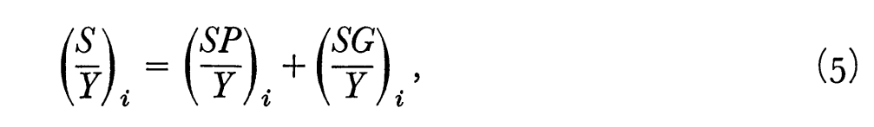
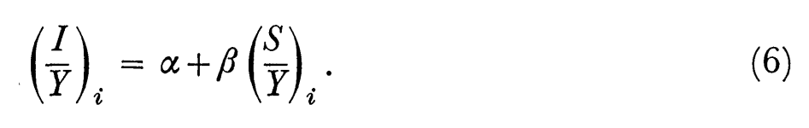
Structural Equation
SG/Y: govt saving ratio

Slide 19
Results
For 12 countries for which data is available for whole sample period:
OLS: β̂ = 0.920 (S.E. = 0.083)
2 SLS β̂ = 0.874 (S.E. = 0.118)
2 SLS (when G excluded) β̂ = 0.795 (S.E. = 0.142)
2 SLS estimates quite similar to OLS ones
Inconsistent with perfect capital mobility
Not inconsistent with a value of at or near one

Slide 20
Components of Saving and Investment
For 9 OECD countries, total saving disaggregated into: HH, C, G
To check whether domestic investment is equally responsive to all types of savings
Relevant for assessing policies that are designed to increase investment by stimulating forms of saving
Investment also disaggregated into: Public and Private, and Private further into HH, C

Slide 21
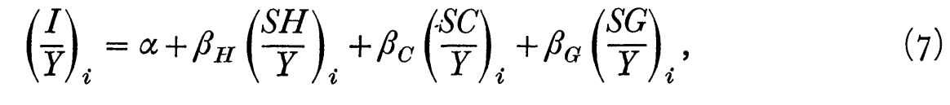
Regression Equation
SH: household saving
SC: corporate saving
SG: govt saving

Slide 22
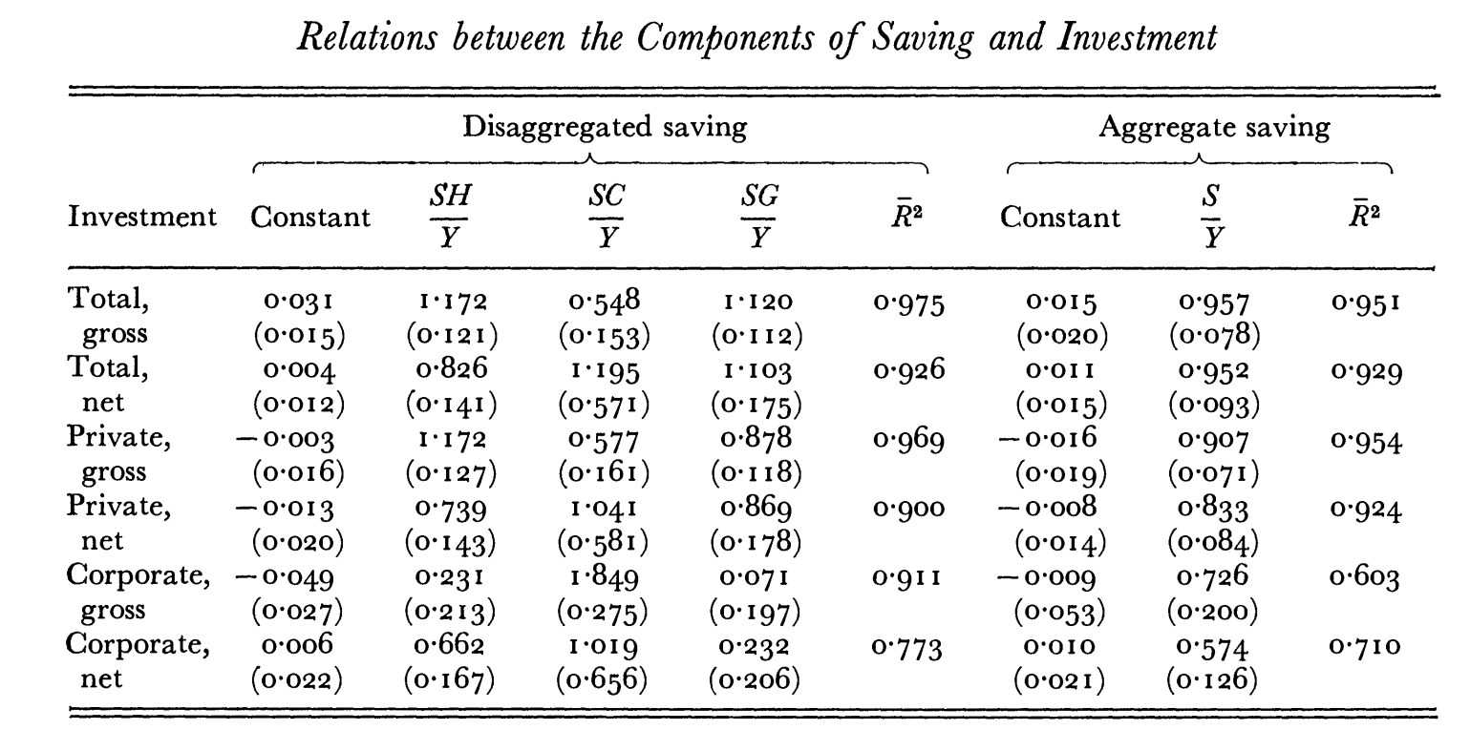
Results

Slide 23
Discussion
not a major difference among the three types of saving in their contribution to total investment or total private investment
Response of total gross investment: coeff (aggregate saving) = 0.957 coeff (household saving) = 1.17 coeff (govt saving) = 1.12 coeff (corporate saving) = 0.55
Null Hypothesis: all three coeff are equal F (calculated) = 4.5 F (tabulated at 5% LoS) = 5.8

Slide 24
Corporate Investment and Corporate Saving
Gross corporate investment to be most sensitive to gross corporate saving (1.849)
Substantially less sensitive to household and government saving (0.231 and 0.071)
May reflect institutional rigidities or portfolio preferences within national economies
Corporations choose to save more in countries where corporate investment is greater

Slide 25
The Response to Changes in Saving Rates
Based on the cross sections of countries, relatively stable differences in savings rate among countries
In short-run: domestic investment may be much less responsive to short-run variations in savings
Equivalent to stating that a larger share of the sort-run fluctuations in the saving rate is reflected in changes in imports and exports

Slide 26
Simultaneity Problem
Estimates of β based on annual time series data are much more likely to be subject to the type of simultaneity bias than estimates based on intercountry differences in saving rates
However, possible to study the response to more sustained changes in saving rates by comparing cross sections of data for different multi-year periods
If the changes in saving between these periods represent responses to basic structural forces, the resulting value of β will be a valid estimate of the response of investment to changes in saving.

Slide 27
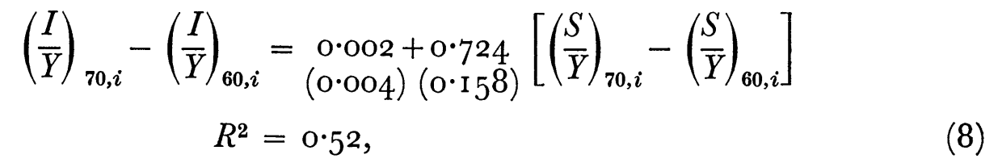
Changes in Investment to Changes in Saving
(I/Y)₇₀: the avg ratio of investment to income during the period 1970 – 74
(I/Y)₆₀: the avg ratio of investment to income during the period 1960 – 69
(S/Y)₇₀: the avg ratio of saving to income during the period 1970-74
(S/Y)₆₀: the avg ratio of saving to income during the period 1960 – 69 Coeff ((S/Y)₇₀ – (S/Y)₆₀) = 0.724
domestic investment rates adjust within a few years to changes in saving rates

Slide 28
Conclusion
Two views of the relation between domestic saving and world capital mobility
Perfect capital mobility: no relation between domestic saving and domestic investment
Imperfect capital mobility: close relation between domestic saving and domestic investment
International differences in domestic savings rates among major industrial countries have corresponded to almost equal differences in domestic investment rates
Hence, the truth lies closer to the second view than to the first

Slide 29
Conclusion
Compatibility of the conclusion with short-term and long-term capital flows
Short-term liquid capital: small part of the world capital stock, used to eliminate interest rate differentials, does not affect the relation between domestic saving and investment
Long-term portfolio and direct investments: made for other motives than equalising returns, such as trade positions or special knowledge, not sensitive to differences in saving rates or capital intensities
Some long-term investments: made for higher yields, but limited by institutional barriers and portfolio preferences
Implication: the conclusion is robust and consistent with the observed patterns of capital movements

Slide 30
Conclusion
Importance of the evidence against world capital mobility and in favour of a close relation between domestic saving and investment
Reveals the true nature of the world capital market and the character of existing long-term capital movements
Confirms the appropriateness of models that ignore international capital mobility for studying income distribution and tax incidence

